Slide 1
The Pesticide Stewardship Alliance Trends in Composite IBC use
Mobile, AL: February 06, 2013

Slide 2
Syngenta Composite IBC purchase trends
"Not as clear-cut as I thought”
2009
2010
2011
2012

Slide 3
Composite IBC purchase trends
2009
2010
2011
2012

Slide 4
Composite IBC purchase trends
Not PCCR Re-fillable compliant
PCCR Re-fillable compliant
2010
2011
2012
2010
2011
2012

Slide 5
Composite IBC purchase trends
Not PCCR Re-fillable compliant
PCCR Re-fillable compliant
Exports and non-refillable totes
2010
2011
2012
2010
2011
2012

Slide 6
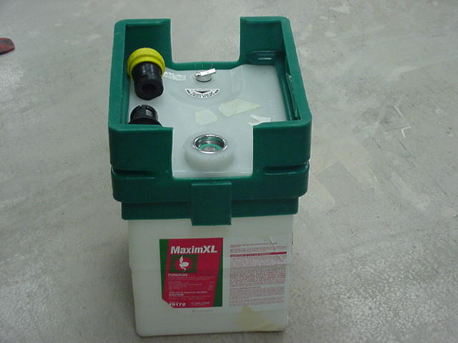
Composite IBC use considerations
Cost
Product Hazard Characteristics (Class 3, Class 8)
Recirculation requirements
Container Refill market strategy. Difference in life expectancy.

Slide 7
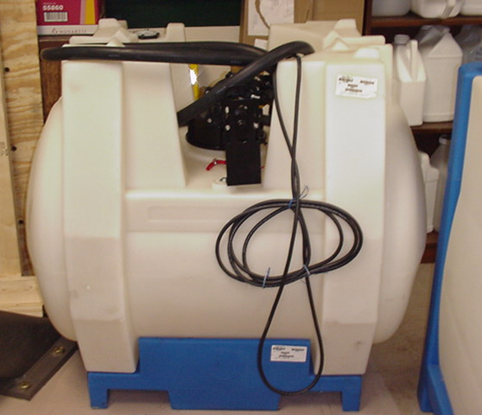
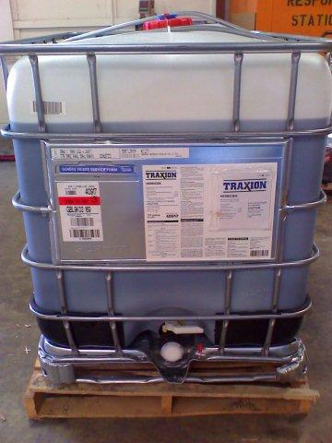
Refill Market Application
How many times can I send this container to the field?

